Slide 1
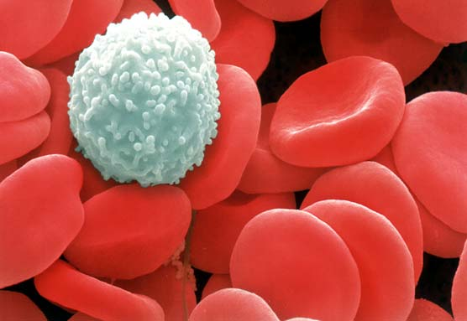
The Human Immune System
Video

Slide 2
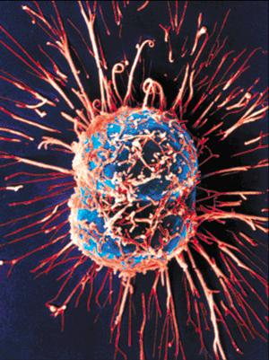
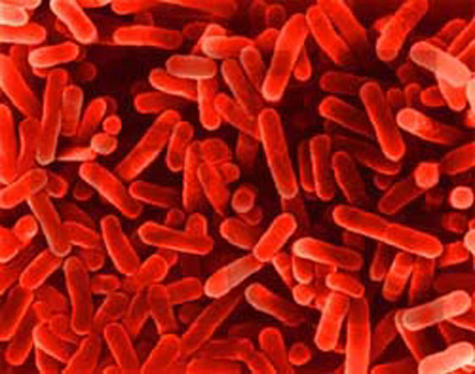
What is the Job of the Immune System?
The body’s defense against pathogens (cause disease), malfunctioning cells ( cause cancer), and foreign particles (cause allergies)

Slide 3
How Does Our Body Know What to Attack?
Antigens (special proteins on cell surface) tell us whether
The cell is our own (SELF)
The cell if foreign (NONSELF)

Slide 4
Overview of the Immune System
Nonspecific Defenses
Specific Defenses
Physical Barriers
Skin
Mucus Membranes
Chemical Barriers
Mucus
Saliva
Stomach Acid
Sweat
White Blood Cells
Phagocytes
Helper T Cells
Cell Mediated Response
Natural Killer T Cells
Antibody Mediated Response
Plasma B Cells
Memory B Cells

Slide 5
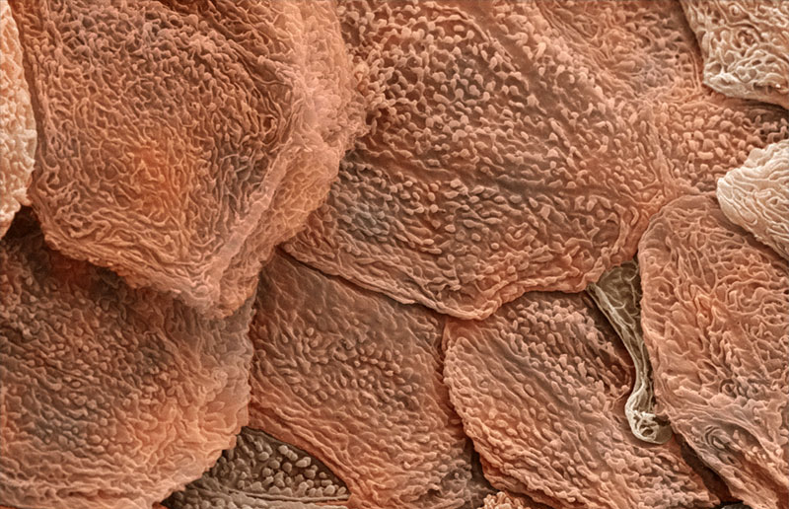
Nonspecific Defense (Attacks anything “nonself”) ~Physical Barrier-Skin~
The dead, outer layer of skin, known as the epidermis, forms a PHYSICAL BARRIER against invaders and secretes chemicals in sweat that kill potential invaders

Slide 6
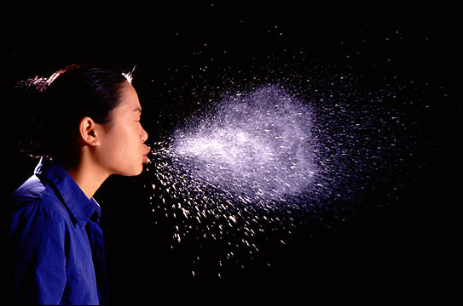
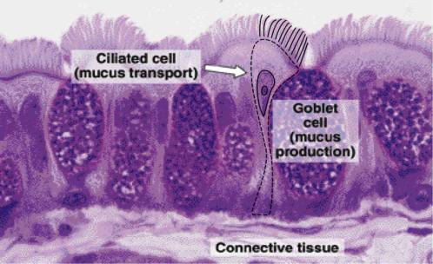
Nonspecific Defense ~Physical Barrier-Mucus and Cilia~
As you breathe in, foreign particles and bacteria bump into mucus throughout your respiratory system and become stuck
Hair-like structures called cilia sweep this mucus into the throat for coughing or swallowing
Don’t swallowed bacteria have a good chance of infecting you?

Slide 7
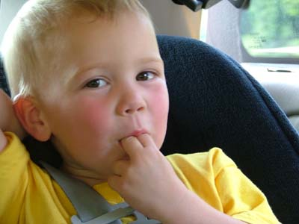
Nonspecific Defense ~Chemical Barriers-Saliva~
What’s the first thing you do when you cut your finger?
Saliva contains many chemicals that break down bacteria
Thousands of different types of bacteria can survive these chemicals, however

Slide 8
Nonspecific Defense ~Chemical Barriers-Stomach Acid~
Swallowed bacteria are broken down by strong acids in the stomach that break down your food
The stomach must produce a coating of special mucus or this acid would eat through the stomach!

Slide 9
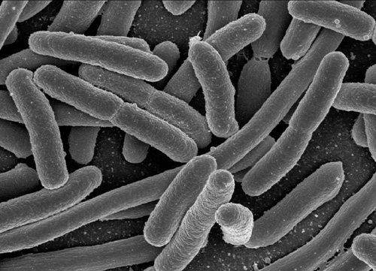
Escherichia coli is common and plentiful in all of our digestive tracts. Why are we all not sick?
These bacteria are technically outside the body (digestive tube that runs from mouth to anus) and aid in digesting material we cannot
Only if E.Coli get out of the digestive tube and into other parts of our body can they cause problems!

Slide 10
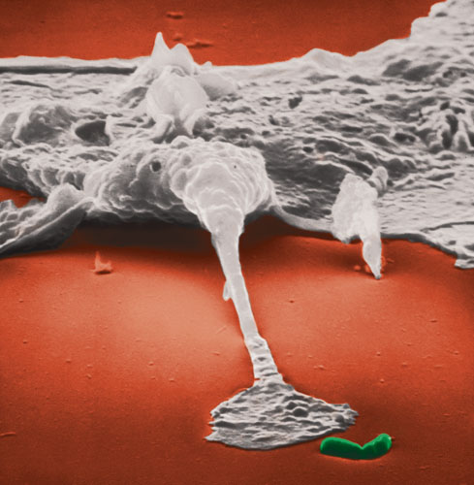
Nonspecific Defense ~White Blood Cells (WBC)~
If invaders actually get within the body, then your white blood cells (WBCs) begin their attack
WBCs normally circulate throughout the blood, but will enter the body’s tissues and increase in numbers if invaders are detected
Video

Slide 11
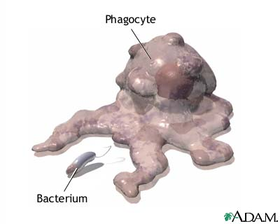
Nonspecific Defense
~Phagocytes (WBC)~
These white blood cells are responsible for eating foreign particles by engulfing them
Once engulfed, the phagocyte breaks the foreign particles apart in organelles called ________
Lysosomes
Where could invaders hide from phagocytes?

Slide 12
Nonspecific-Specific Defense ~Helper T Cell~
Begin their work when a phagocyte eats a pathogen
They activate the 2 Parts of the Specific Defense System
Don’t actually get involved in the fight (more of a messenger role)

Slide 13
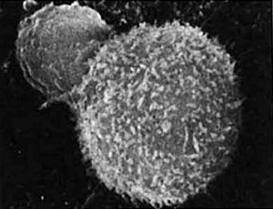
Specific Defense (WBC) (kills only one type of pathogen) Part #1: Cell Mediated Response ~Killer T-Cells~
One type of T cell called “natural killer” cells, recognize infected human cells and cancer cells
T-cells will attack these infected cells, quickly kill them, and then continue to search for more cells to kill

Slide 14
Specific Defense (WBC) Part #2: Antibody Mediated Response ~B Cells~
There are two different types of B Cells
Plasma B Cells produce the antibodies
Memory B Cells remember the antigen for help in future immunity

Slide 15
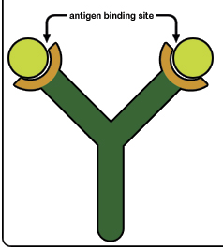
Specific Defense (WBC) Part #2: Antibody Mediated Response ~Plasma B Cells~
Luckily, most infections never make it far enough for us to need the B Cells!
Those that do trigger the production and release of antibodies
Proteins that latch onto, damage, clump, and slow foreign particles
Each antibody binds only to one specific antigen on a foreign cell

Slide 16
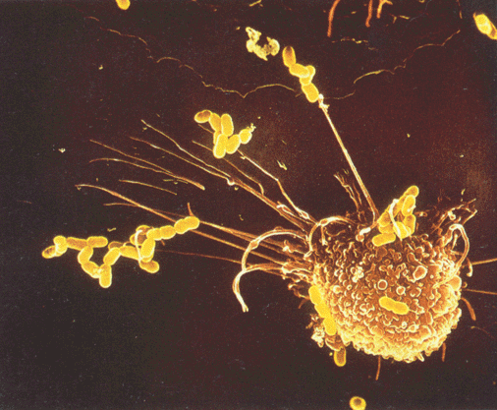
Steps in Antibody Production
Phagocytes (WBC) gobble up invading particles and break them into small pieces that they stick out of their cell membrane.
They show these pieces to Helper T-cells (WBC) who try to find the right B-cells to help. (only 1 B cell for each pathogen)
Plasma B-cells produce antibodies that attach to the antigen on that pathogen and make it non-functional.
HURRAY!!!
Video - 1:58

Slide 17
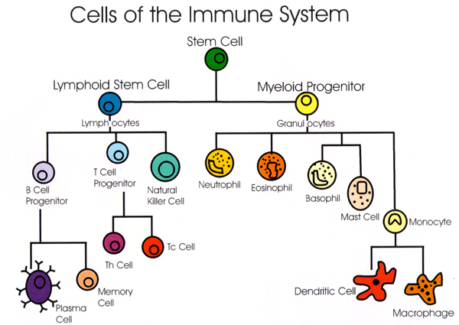
Specific Defense (WBC) Part #2-Antibody Mediated Response ~Memory B Cells~
New pathogens take longer to identify, and a person remains ill until a new antibody can be made.
Old pathogens are quickly recognized, and a person may never become ill from that invader again. This person is now IMMUNE!

Slide 18
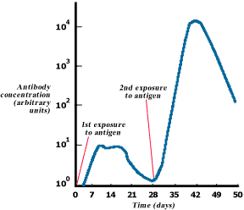

Slide 19
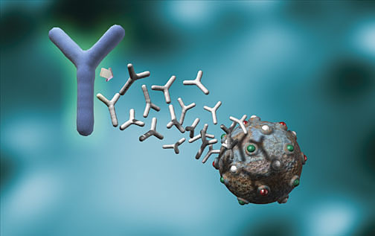
What is immunity?
Resistance to a disease causing organism or harmful substance
Two types
Active Immunity
Passive Immunity

Slide 20
Active Immunity
You produce the antibodies
Your body has been exposed to the antigen in the past so you have MEMORY B CELLS for that pathogen by
Accidental exposure to the actual disease causing antigen – You FOUGHT it, you eliminated it, you remember it (you had the disease)
Planned exposure to a form of the disease causing antigen that has been killed or weakened – You DETECTED it, eliminated it, and remember it (you got vaccinated)

Slide 21
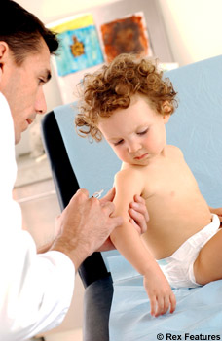
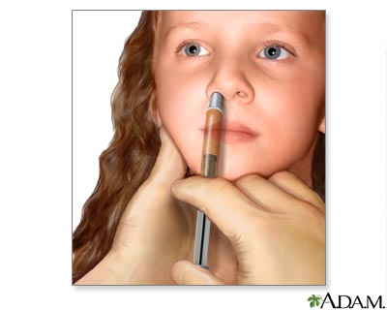
Vaccine
Antigens are deliberately introduced into the immune system to produce immunity
Because the bacteria has been killed or weakened, minimal or no symptoms occur (you don’t get sick)
Have eradicated or severely limited several diseases from the face of the Earth, such as polio and smallpox

Slide 22
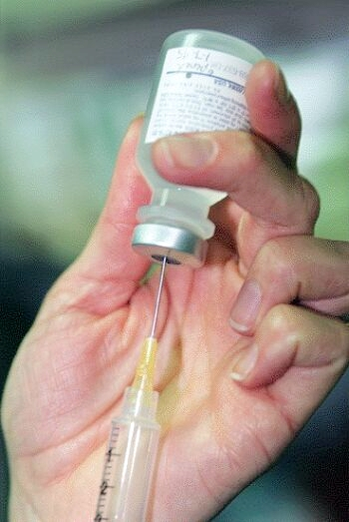
How long does active immunity last?
It depends on the antigen
Some disease-causing bacteria multiply into new forms that our body doesn’t recognize, requiring annual vaccinations, like the flu shot
Booster shot - reminds the immune system of the antigen
Others last for a lifetime, such as chicken pox

Slide 23
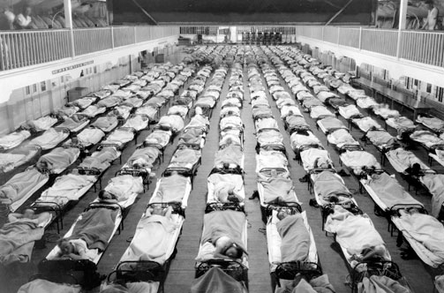
Think the flu is no big deal?
Think again…
In 1918, a particularly deadly strain of flu, called the Spanish Influenza, spread across the globe
It infected 20% of the human population and killed 5%, which came out to be about 100 million people

Slide 24
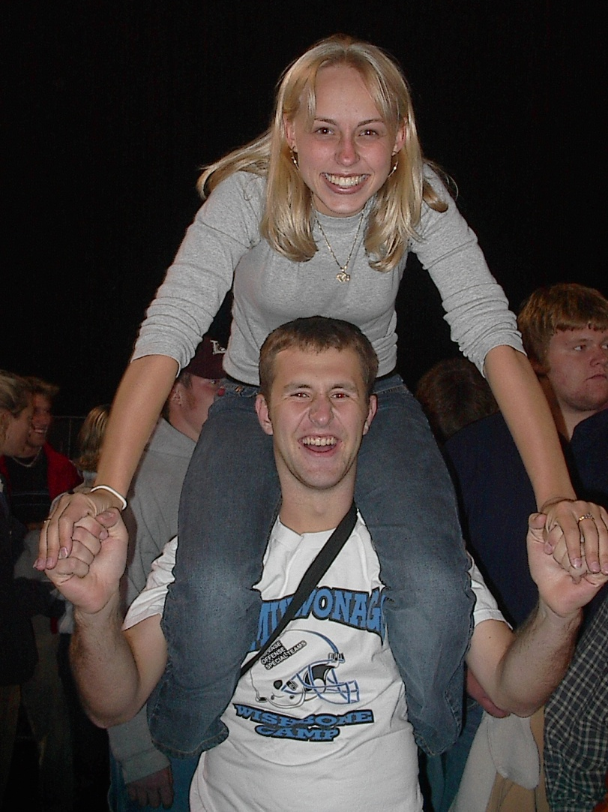
Do we get all the possible vaccines we can?
Although the Center for Disease Control (CDC) recommends certain vaccines, many individuals go without them
Those especially susceptible include travelers and students
Consider the vaccine for meningitis, which is recommended for all college students and infects 3,000 people in the U.S., killing 300 annually
Link

Slide 25
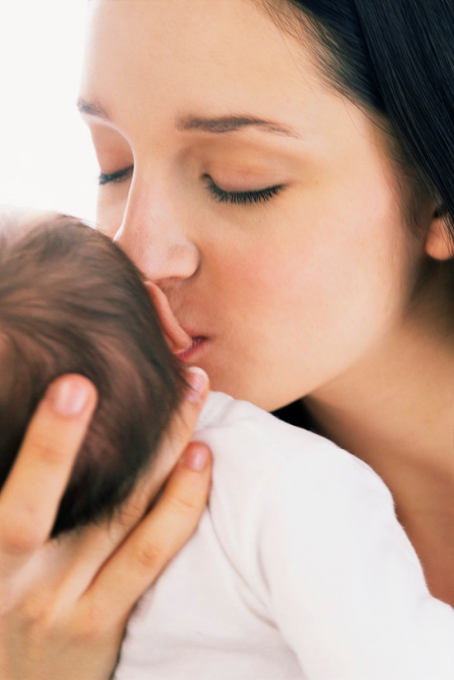
Passive Immunity
You don’t produce the antibodies
Example:Mother gives antibodies to baby during pregnancy
Only works for short time following birth while baby’s immune system develops.
No long term immunity because no Memory B cells will be produced
Why doesn’t the mother just pass on the WBCs that “remember” the antigens?

